Slide 1
ACT Seminar 68 Economic Outlook
Jim Meil
Principal, Industry Analysis
February 22, 2023

Slide 2
Big Picture Summary
Recession lite may have started; then again, maybe not
Sector variance make this “R” a different beast
  Trouble in housing, tech, retail (inventories)
  Cars, consumers, mfg soft but ahead of the average “R”
Inflation relief = Fed hikes slow H1; drop rates H2?
Focus increases on H2, as to whether it’s R, or post-R

Slide 3
Good news, bad news
Bad news
Good news
Interest rates impact Main Street 6 mo lag
Consumers anxious, but…
Inventories in retail too high
Housing peaked a year ago & still declining
Diesel not following crude prices down
New tech sector layoffs almost daily
Politics – DC circus, House Speaker vote
China more difficult than ever
Rus-Ukr war drags on, no end in sight
Recent data flow upbeat
…anxious consumers are spending
Super strong job market
  unemployment 3.4%
  11 million jobs open, near a record
Inflation gradually retreating
Pent-up demand for autos, CV, and other durables
Energy prices down from peak
COVID severity declining in NA
Updated: February 15, 2023

Slide 4
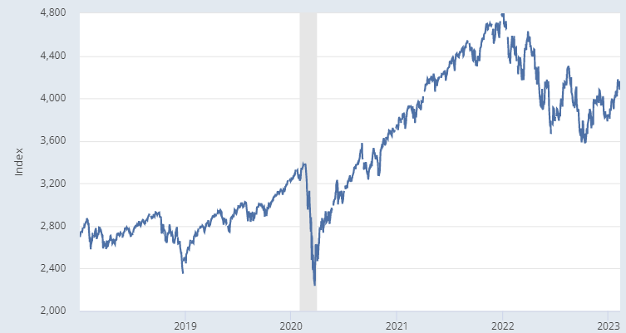
Lessons from equities
2022 down 19%, 2023 ytd up 7.5%
February 15, 2023
4136.56 up 15.6% from Oct 12
January 3, 2022 peak 4796.56
Five months of Oct to Feb OK, up 15.6%
---------------------------
20% correction on 2022 H1 shocks
Inflation
Rus - Ukraine
Fed rate hikes
China COVID
Recession risk
February 19, 2020
3386.15
October 12, 2022 low
3577.03
March 23, 2020
2337.40
ACT Research Co., Copyright 2023
4

Slide 5
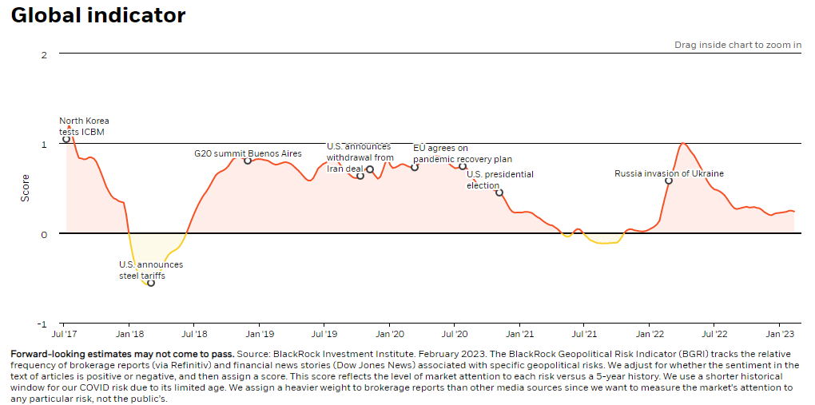
High risks of de-globalization, COVID, Rus-Ukr now easing
BlackRock global geopolitical risk indicator July 2017 to date
Source: BlackRock Geopolitical Risk Dashboard
https://www.blackrock.com/corporate/insights/blackrock-investment-institute/interactive-charts/geopolitical-risk-dashboard#risk-indicator

Slide 6
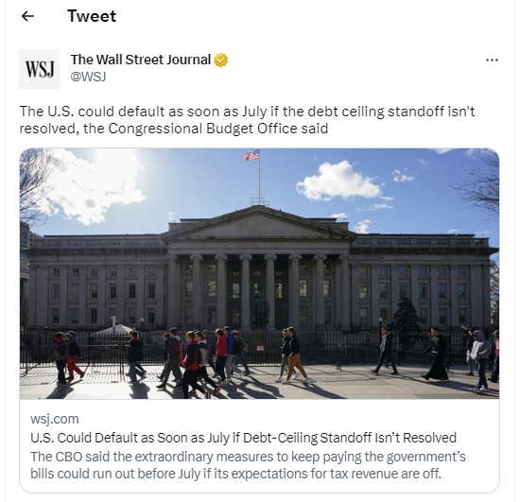
CBO warns of July debt ceiling default risk
Tight November election results empower House of Representative extremists
------------------------------------
Chaotic House Speaker vote as portent of July snafu

Slide 7
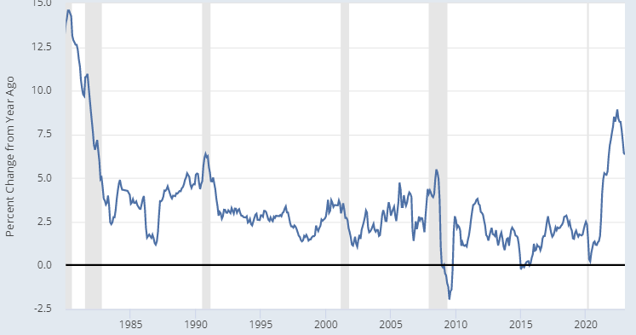
Inflation: gradual retreat in CPI
6.3% y/y in Jan
After 42-year high in June @ 9.0%
Still a big distance to cover to 2% FOMC goal

Slide 8
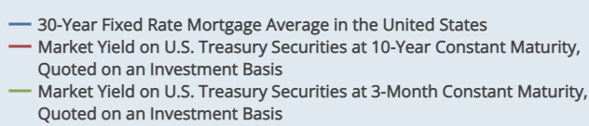
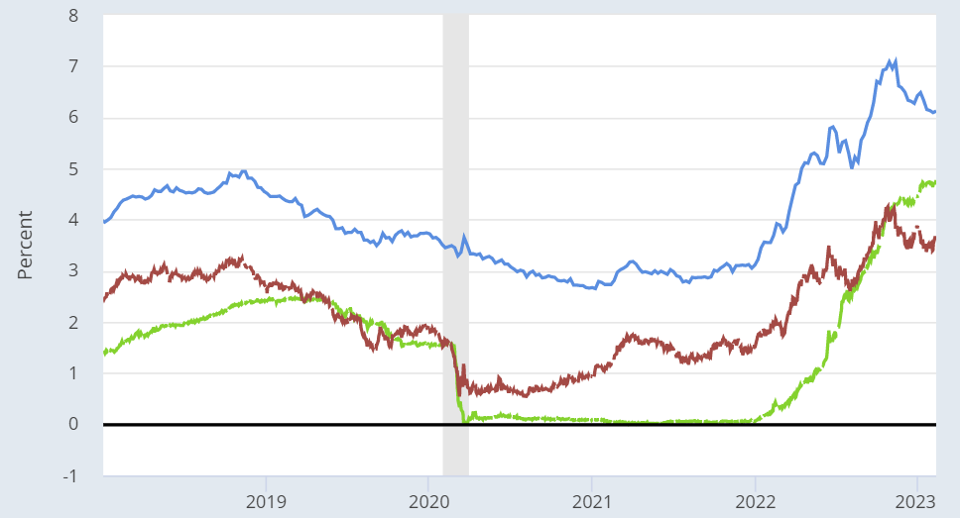
Interest rates up over most of 2022…
…but mixed story in last 4 months
Fed still raising rates
(green line) but…
Longer-term rates are buying the story on inflation retreat
Red (10 yr Tbond)
Blue (30 yr mortgage)

Slide 9
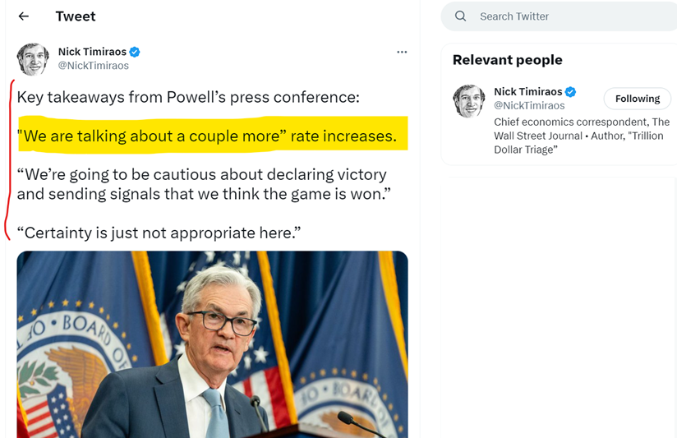
Fed is not done – Powell Feb 1 press conf

Slide 10
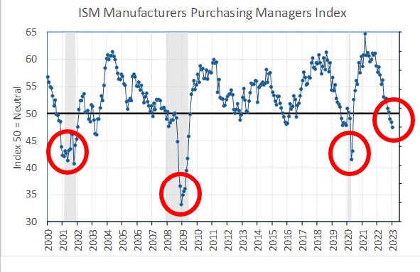
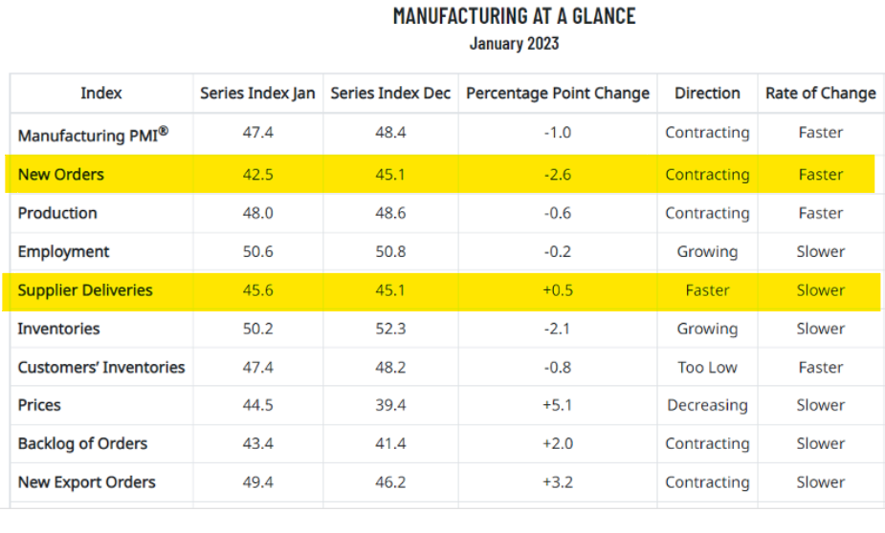
ISM Purchasing Managers approaches recession territory

Slide 11
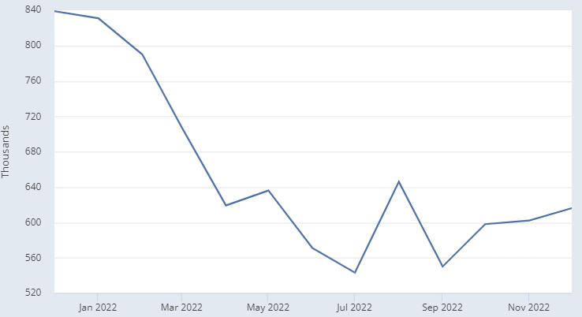
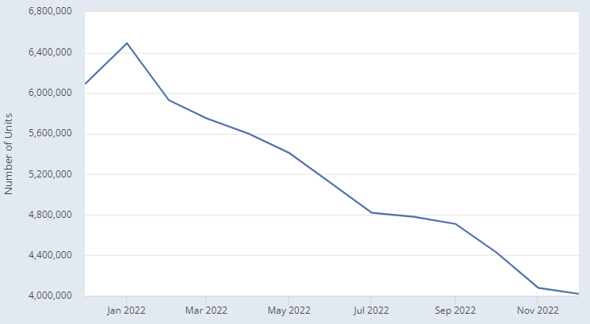
Housing in recession
Fallout on building materials, appliances, furnishings
New home sales down 27% Dec 2022 from Dec 2021
Existing home sales down 38% Dec 2022 from Jan 2022

Slide 12
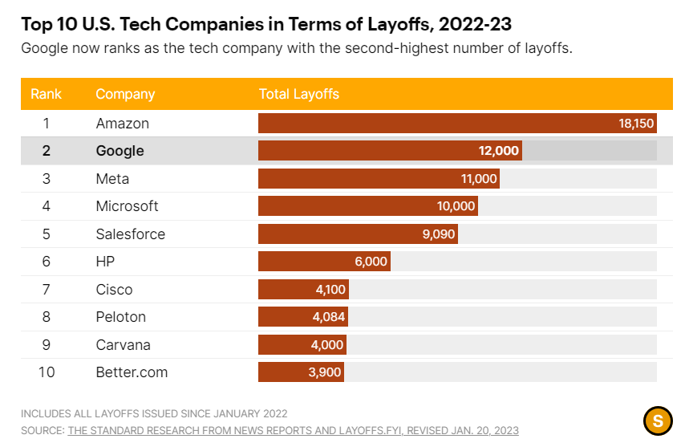
Tech layoffs in multiple 10,000s
Not just software…Dell, HP, Intel, Cisco, IBM, and others
TECH IS VULNERABLE
Layoffs have knock-on impact in housing – Bay Area, Seattle, Portland, other

Slide 13
Purchasing Managers Indexes
Swimming in a sea of yellow

Slide 14
US Economic Policy Uncertainty Index
JUMP IN JANUARY
Threat of debt ceiling standoff rises with House Speaker snafu
Source: “Measuring Economic Policy Uncertainty” by Scott Baker, Nicholas Bloom and Steven J. Davis at www.PolicyUncertainty.com. These data can be used freely with attribution to the authors, the paper, and the website.

Slide 15
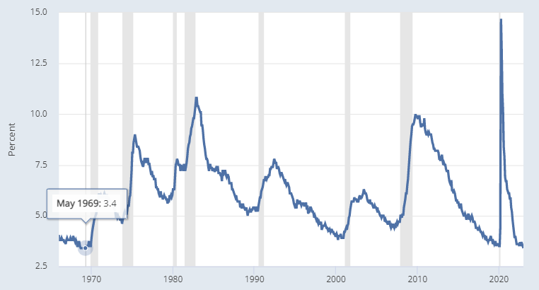
Super-strong labor market
JOB MARKET ON FIRE
3.4% unemploy rate
517k net new Jan jobs
11 million job openings
in US, nearly a record
January 2023: 3.4

Slide 16
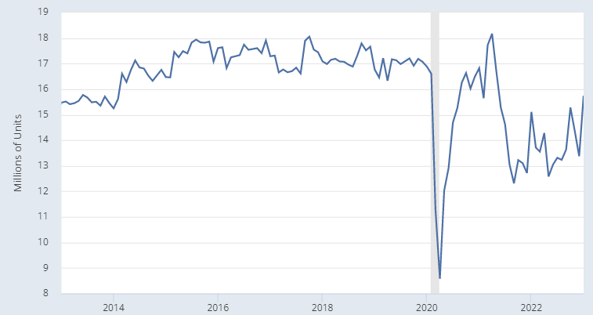
Buyers still lining up for new autos
PENT-UP DEMAND FOR NEW AUTOS
16.9m pre-COVID
norm 2013-2020
13.8m in 2022

Slide 17
No swan dive for interest-rate sensitive cap goods
(like Classes 4 to 8 trucks)
PENT-UP DEMAND FOR CAPITAL EQUIPMENT
Flat lining, no collapse like Great Recession, COVID Recession, even 2015-2016 retreat
Note: Data series Census M3 Capital Goods excluding Aircraft, deflated by PPI Capital Equipment (Private)

Slide 18
Summary Indicator Forecast Table
Made early recession call in July 2022…
Some doubts creeping in with start-of-2023 strength

Slide 19
Big Picture Summary
Recession lite may have started; then again, maybe not
Sector variance make this “R” a different beast
  Trouble in housing, tech, retail (inventories)
  Cars, consumers, mfg soft but ahead of the average “R”
Inflation relief = Fed hikes slow H1, drop rates H2?
Focus increases on H2, as to whether it’s R, or post-R

Slide 20
ACT Research Company
4440 Middle Road
Columbus, IN 47203
Phone: (812) 379-2085
Fax: (812) 378-5997
Email: trucks@actresearch.net
www.actresearch.net

